Slide 1
Hanami and Ramen
Antonio Cruz | IBM APPLIED DATA SCIENCE CAPSTONE PROJECT

Slide 2
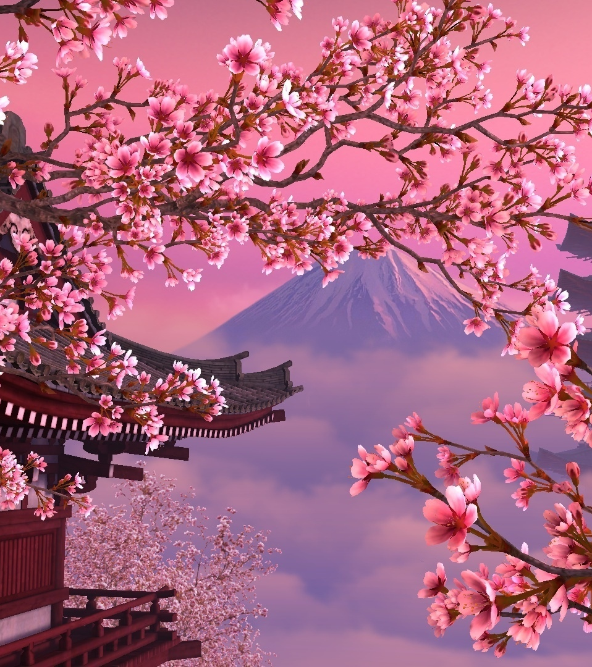
Outline
Introduction
Data
Methodology
Analysis
Results and Discussion
Conclusion

Slide 3
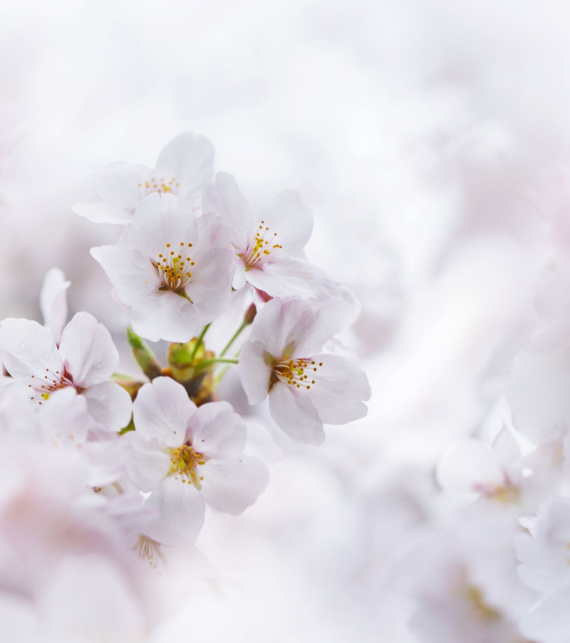
Introduction
What is Hanami?
Hanami is the traditional custom of viewing and enjoying the beauty of flowers (mainly cherry blossoms) and springtime in Japan.
To enjoy Hanami, one can admire from a distance in which the cherry blossoms have been described as appearing as beautiful clouds, have a picnic under the blooming trees, or enjoy a nice stroll through a park under the blooming trees.
Each year forecasts are made for the cherry blossom front, the northward advancement of the blooming of cherry blossoms across Japan. These forecasts are closely followed by those who wish to enjoy Hanami as the blossoms typically last for one to two weeks.

Slide 4
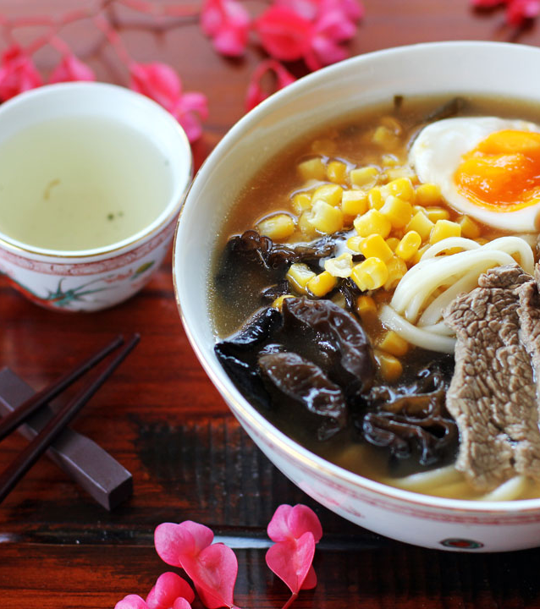
Introduction
What is Ramen?
While the exact origins of ramen noodles is up to debate (Japan or China origin), what is not up for debate is how Ramen shops across Japan have really made Ramen their own.
Ramen in simple terms are wheat-flour noodles served in broth.
With more than 10,000 ramen shops in Japan, each shop provides a different take on the dish of Ramen.
Goal of this project
Identify locations in Japan in which to enjoy both Hanami and Ramen:
Date range of: April 15th to May 15th
List of recommended Cherry Blossom viewing spots (RCBs)
Number of Ramen Shops around each of the RCBs
Distance to Train Station from RCBs
This Photo by Unknown Author is licensed under CC BY-NC-ND

Slide 5
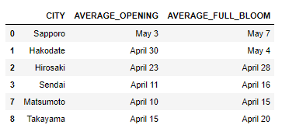
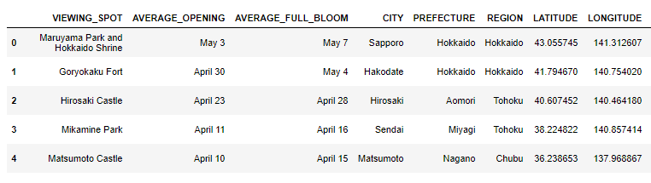
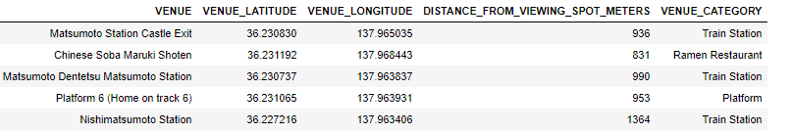
Data
What is needed?
Cities in Japan Average Cherry Blossom Blooming Dates
Average Cherry Blossom Blooming dates for desired date range https://www.japan-guide.com/e/e2011_when.html.
Recommended Cherry Blossom viewing spots (RCBs) https://www.japan-guide.com/e/e2011_where.html
Information for each location obtained: City, Name, Description, Rating
Reverse geocoding to obtain geographical information for each RCBs
Information obtained: Prefecture, Region, City, Coordinates
Utilizing Four Square to obtain location data for Ramen Shops and Train Stations near the RCBs.
Information obtained: Venue Name, Venue Coordinates, Venue distance from RCB (meters), Venue Category
All together, a total of 225 venues were found near each of the RCBs (1.25-mile radius).
Recommended Cherry Blossom viewing spots with reverse geocoding information
(columns not shown: Description, Rating, Rating Description)
5 of the 225 venues around the recommended Cherry Blossom viewing spots

Slide 6
Methodology
In this project, we attempted to find locations in which a person can enjoy the beauty of cherry blossoms and a bowl of delicious Ramen within proximity of a train station.
The data from Four Square contained excess train station venues around some of the train station locations. This was remedied through use of Hierarchical Clustering/Agglomerative Clustering and reduced the overall total of train station venues.
Each of the RCBs were plotted along with the venues in the surrounding area to allow for a visualization of the layout of the venues.
Compared RCBs with each other using bar charts.
Finally, choices for which location may be best to enjoy Hanami and Ramen were made based on three different criteria:
Number of Ramen Shops
Distance to Train Station
Rating of each RCB

Slide 7
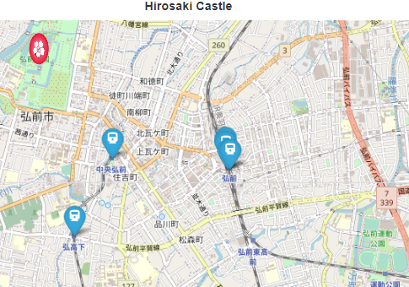
Analysis
Hierarchical Clustering/Agglomerative Clustering
Excess train station venues around some of the train station locations were returned from the Four-Square API.
Hirosaki Castle, there are 5 train station venues for Hirosaki Station
The number of train station were reduced by Agglomerative Hierarchical Clustering:
Number of clusters determined from dendrograms by use of a threshold line across the 0.002 Euclidean distance, which represent approx. 200 meters.
Any venue within 200 meters of another venue are clustered together
Cluster labels were used to cluster nearby train station venues into one train station venue.
Hirosaki Castle’s dendrogram and cluster map are shown in next slide as an example of the process.

Slide 8
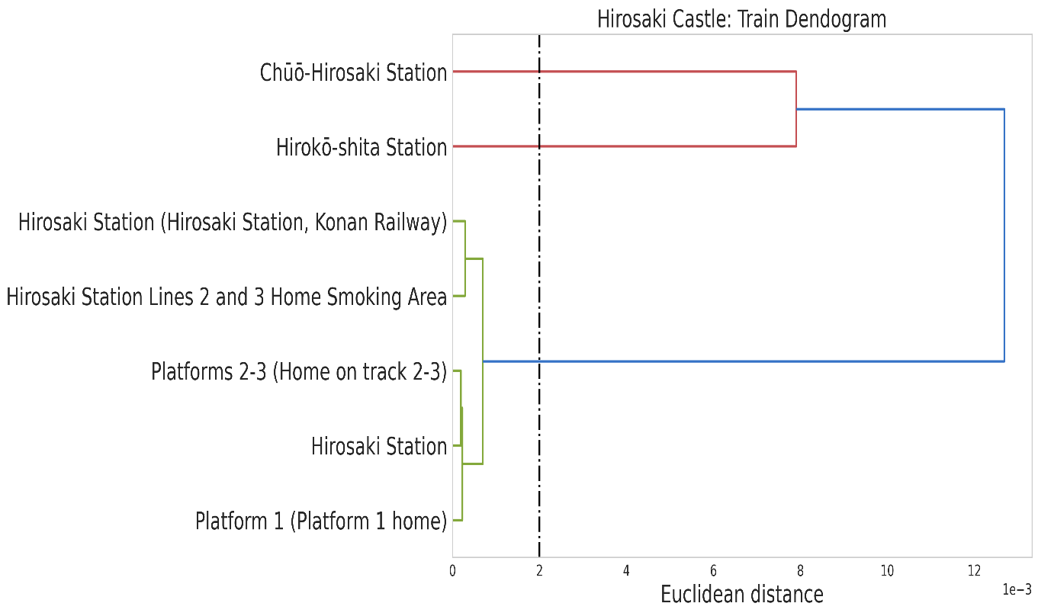
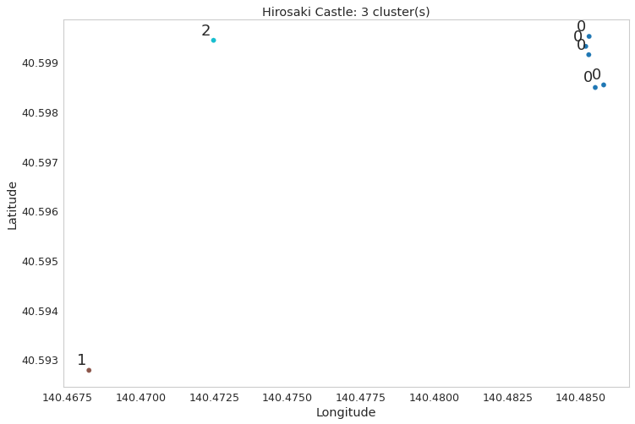
Analysis
Hierarchical Clustering/Agglomerative Clustering
Hirosaki Station
0.002 Euclidean distance threshold line crosses dendrogram at 3 instances,
meaning 3 Train Station Clusters
3 clusters: Cluster 0, Cluster 1, Cluster 2

Slide 9
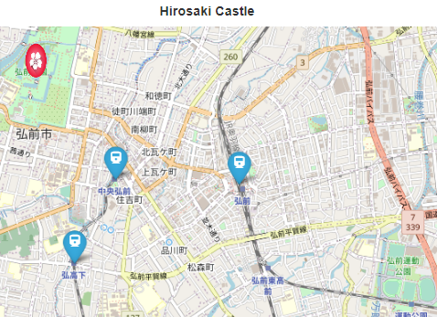
Analysis
Hierarchical Clustering/Agglomerative Clustering
Hirosaki Station : Originally there were 5 train station venues. With Hierarchical Clustering, these venues were clustered together into 1 train station venue.
This process was repeated for each of the 5 RCBs.
This reduced the total amount of train station venues from 42, down to 16 across the areas around the 5 RCBs.
With the clustering of train station venues completed, the surrounding areas around the RCBs were plotted along with the venues in the surrounding area to allow for a visualization of the layout of the venues.

Slide 10
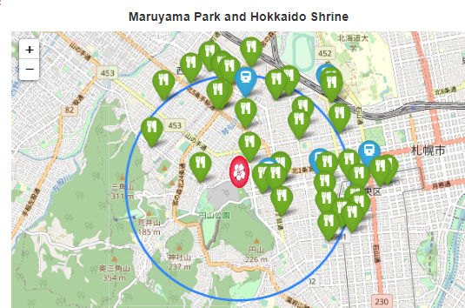
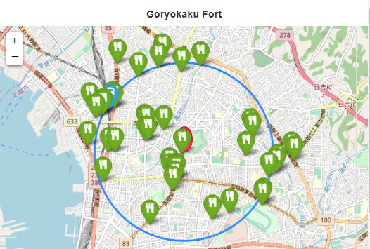
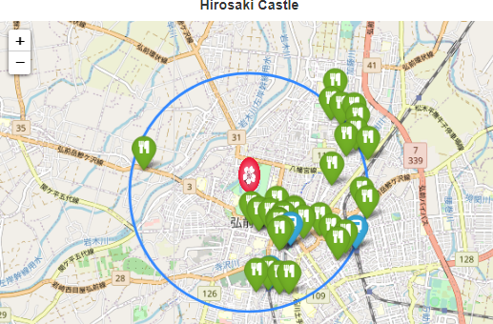
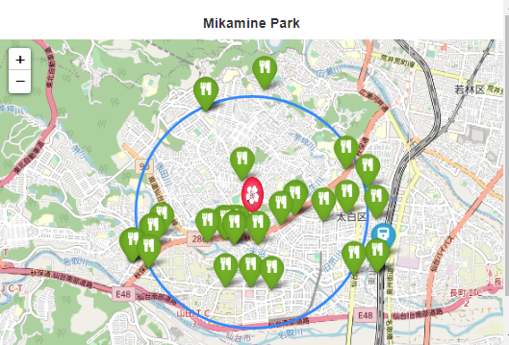
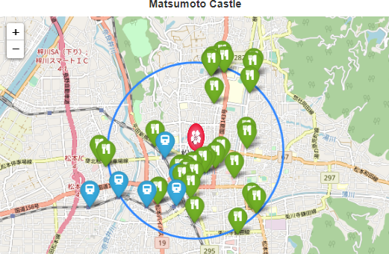
Analysis
RCBs and surrounding Venues
Green markers with a cutlery icon mark the location of Ramen Restaurants/Shops
Blue markers with a train icon mark the location of Train Stations.
The Sakura markers mark the location of each RCB.
The blue circles each have a radius of 1.25 miles and is centered on the location of their RCB.
Looking at the maps for each of the RCBs, it seems Four-Square returned venues that where well outside of the desired radius of 1.25 miles.

Slide 11
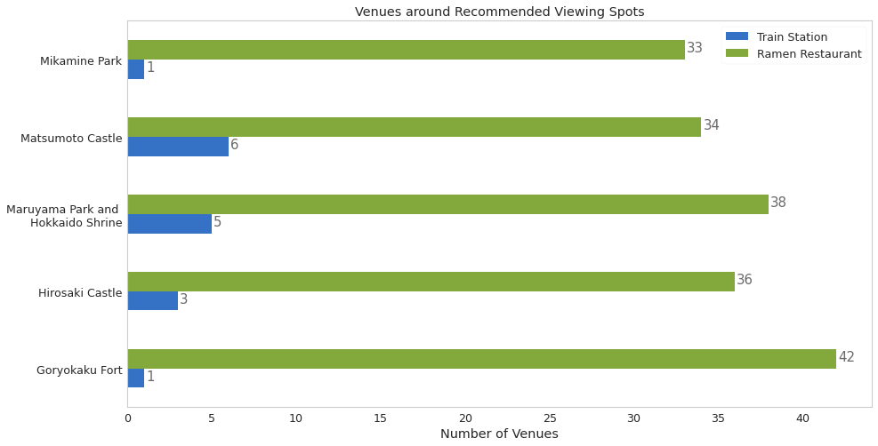
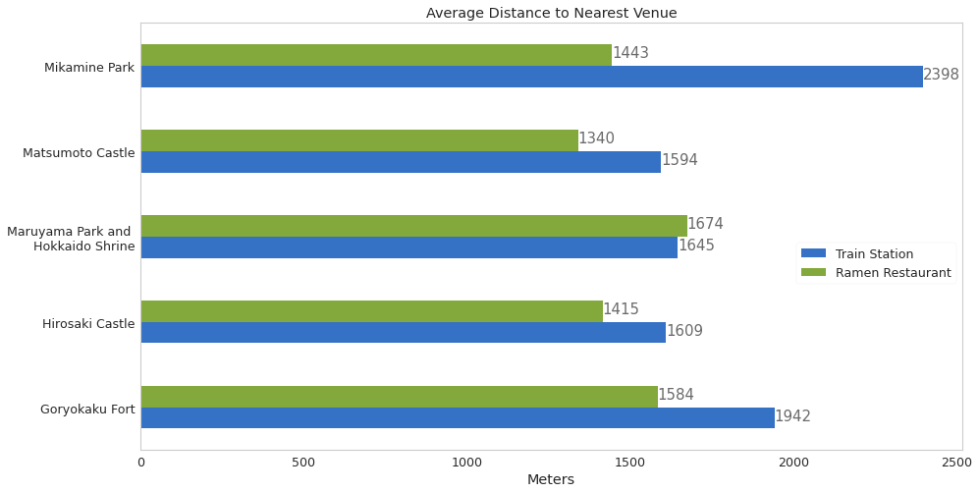
Results and Discussion
Ramen Shops
Based off Chart 1 for number of Ramen Shops
Goryokaku Fort would be the best with 42 Ramen Shops
Mikamine Park would be the worst with 33 Ramen Shops
Based off Chart 2 for average distance to a Ramen Shop
Matsumoto Castle would be the best with an average distance of 1340 meters (~0.83 miles).
Maruyama Park and Hokkaido Shrine would be the worst with an average distance of 1674 meters (~1.04 miles)
Chart 1
Train Stations
Matsumoto Castle
6 Train Stations, all within an average distance of 1594 meters (~0.99 miles).
Mikamine Park
Only 1 Train Station, located 2398 meters (~1.49 miles) away
Chart 2

Slide 12
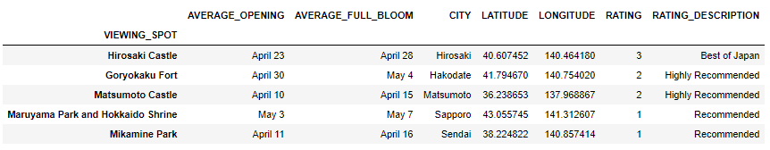
Results and Discussion
Rating System
Another criterion to select the best RCB is to use the rating system found at https://www.japan-guide.com/e/e2011_where.html
The ratings range from 1 to 3:
Recommended
Highly Recommended
Best of Japan
Based off this system, Hirosaki Castle is the best from the RCBs with a Best of Japan rating.

Slide 13
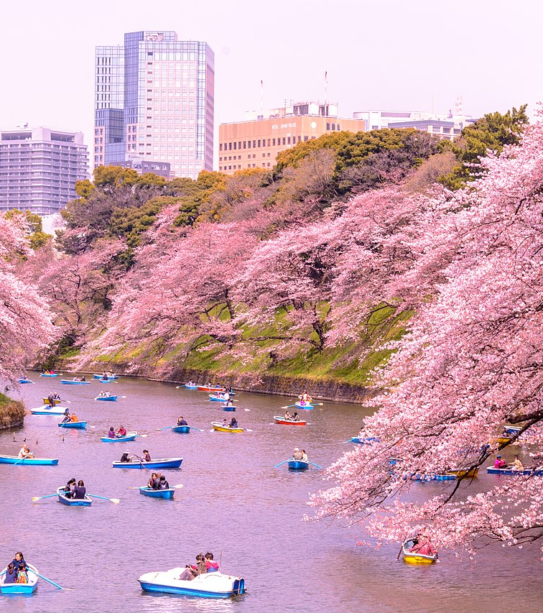
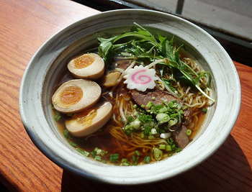

Conclusion
In this project, we identified some of the best locations in Japan in which to enjoy both Hanami and Ramen from April 15th to May 15th.
These locations would be easy to travel to based off their proximity to train stations.
Using Hierarchical clustering, multiple train station venues were clustered together to form a single train station.
We were able to compare the number of venues around each of the RCBs by using bar charts.
Each of the RCBs have a good number of choices for Ramen Shops located nearby.
Overall, there are many different locations a person can visit to enjoy springtime and the cherry blossoms in Japan. The biggest factor to keep in mind is the when. With cherry blossoms lasting a short time span and the cherry blossom front traveling from south to north, a person needs to keep the time of year in mind when planning a trip to Japan to experience the tradition of Hanami (also to enjoy a bowl of Ramen)
This Photo by Unknown Author is licensed under CC BY-SA

